Slide 1


TEAM 4 AGENCY
15/05/24
HAU Certificate in Digital Marketing
#haudigital #digitalmasters

Slide 2
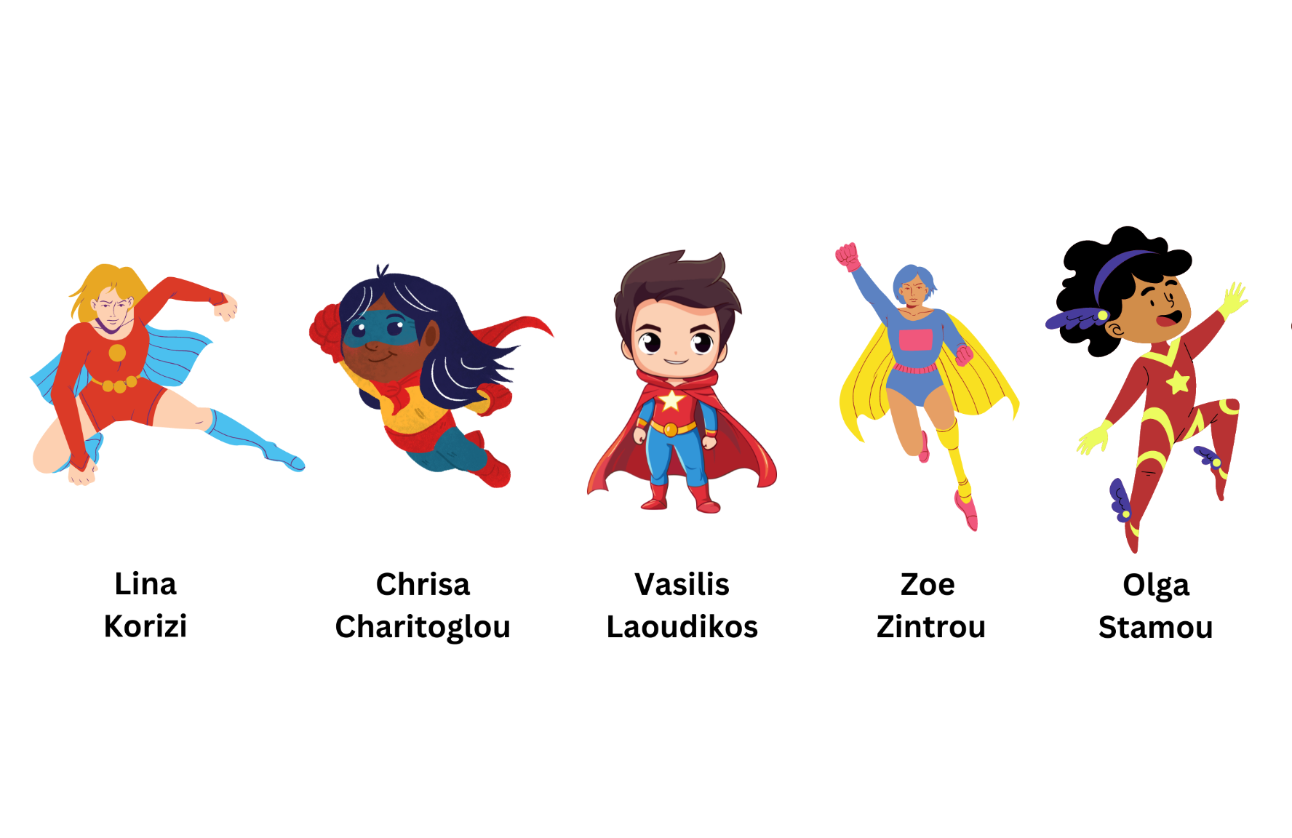
THE TEAM

Slide 3
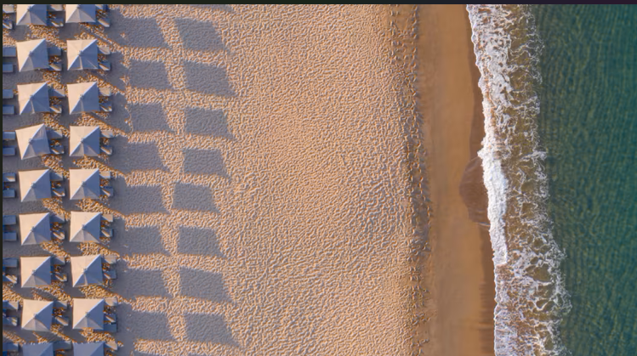
TABLE OF CONTENTS
Identity
Competition
Swot Analysis
Persona
Main Goals
Strategy
Budget

Slide 4
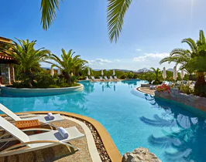
IDENTITY
Located in the Navarino Dunes area along the Ionian Sea.
Won Condé Nast Traveller’s 2022 Readers’ Choice Award for best resorts worldwide.
Family-friendly activities
Sports facilities
Locally sourced cuisine
Cultural experiences

Slide 5
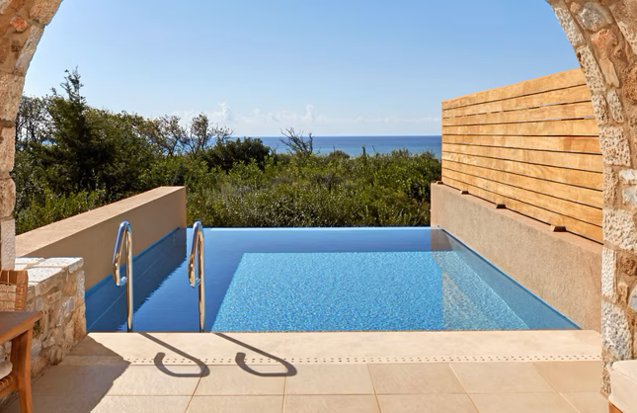
COMPETITION
Domestic
Amanzoe, Porto Heli
Sani Resort, Chalkidiki
Elounda Beach Hotel & Villas, Crete
Santa Marina, Mykonos
International
The Ritz-Carlton, Dubai, UAE
St. Regis Bora Bora Resort, French Polynesia
Four Seasons Resort Bali at Jimbaran Bay, Indonesia

Slide 6
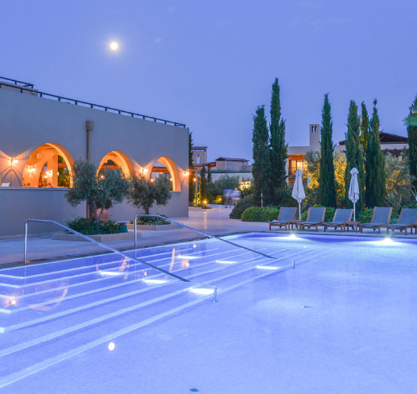
SWOT ANALYSIS
Strengths Location Brand Reputation Facilities Cultural Experience | Weaknesses Seasonality Accessibility Infrastructure Challenges
Opportunities Market Expansions Digital Marketing Partnerships Infrastructure Development Innovation | Threats Economic Downturns Competition Natural Disasters Political Instability Environmental Factors

Slide 7



PERSONA
Persona 1: Luxury Leisure Travelers
Gender: Any | Age: 30-50 | Ethnicity: Any
Industry: Technology, Finance, Legal
Job: Middle to Senior Management
Income: High (>$100,000 per year)
Values luxury and exclusivity, seeks relaxation and rejuvenation, enjoys indulging in high-end experiences.
Persona 2: Affluent Family Planner
Gender: Any | Age: 35-50 | Ethnicity: Any
Industry: Various Job: Professionals
Income: High Prioritizes family time, values experiences over products, looks for activities that can be enjoyed by both adults and children.
Persona 3: Wellness Seekers
Gender: Any | Age: 30-55 | Ethnicity: Any
Industry: Health & Wellness Job: Health Professionals, Wellness Coaches
Income: Moderate to High Highly values personal health and wellness, regularly engages in wellness activities like yoga and meditation

Slide 8
STRATEGY

Slide 9
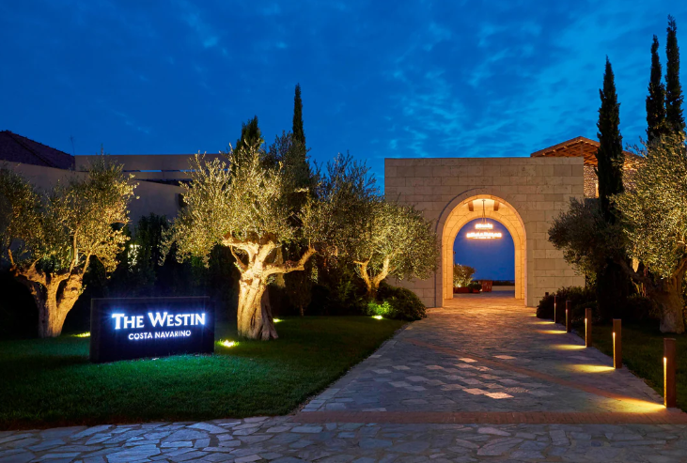
MAIN GOALS
Enhance brand awareness
Increase booking in relation to last year, target fully booked season
Increase off-season bookings
Notes:
April- May: ad for awareness to enhance summer bookings (families etc) (social media, email remarketing)
July- August: ad for conversion (spontaneous buyers, rich clientele) (social media,
influencer marketing)
September: ad for retreat month (social media, google ads, email remarketing,
publishers)

Slide 10
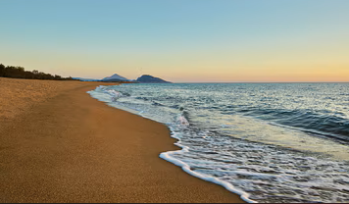
TOOLS
Facebook
Instagram
LinkedIn
Google Search Ads
Influencers
Publishers
Email marketing

Slide 11
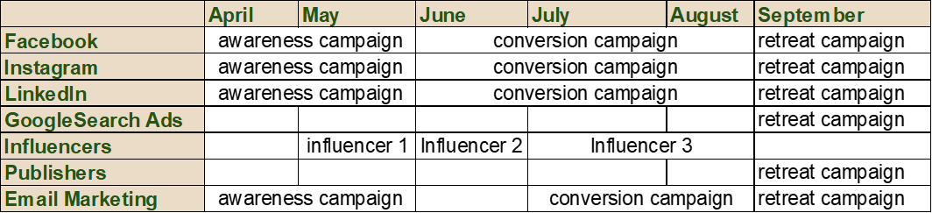
STRATEGY

Slide 12

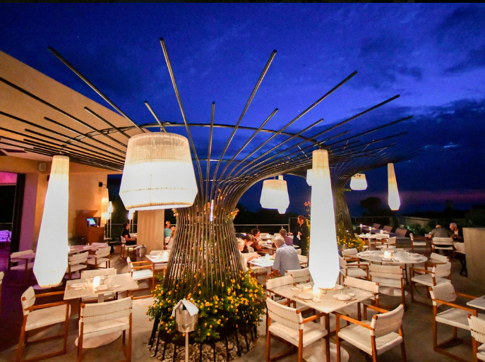
VOICE
Slogan:
“It's not just luxury, is a way of living. Indulge your senses in the Westin Costa Navarino experience.”
Tone of voice:
Luxurious, serious, premium, corporate, high class, vip, jet set.
Main Elements:
Luxury, family experience, personalized experience, mediterranean beauty, wellness retreat, sports destination, premium mediterranean culinary experience

Slide 13
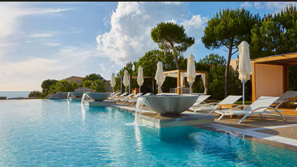
CREATIVE CONTENT
Main Copy:
The Westin Costa Navarino family is excited to welcoming you to spend your most unforgettable summer in our magical Greek paradise.
Choose from our countless activities to create your own personalized holiday experience and join us to unwind in the most luxurious hidden wellness paradise.
Hashtags:
#westin #westincostanavarino #summerloading #luxurydestination #luxurytravel #luxuryresort #luxuryhotel #luxuryworldtravel #luxuryescapes #greece #messinia #familyvacations #familyresort #wellness #spa #spatreatments #bepartofourstory #navarinomoments #golftournament #golfcourt #sportdestination #tennisdestination

Slide 14
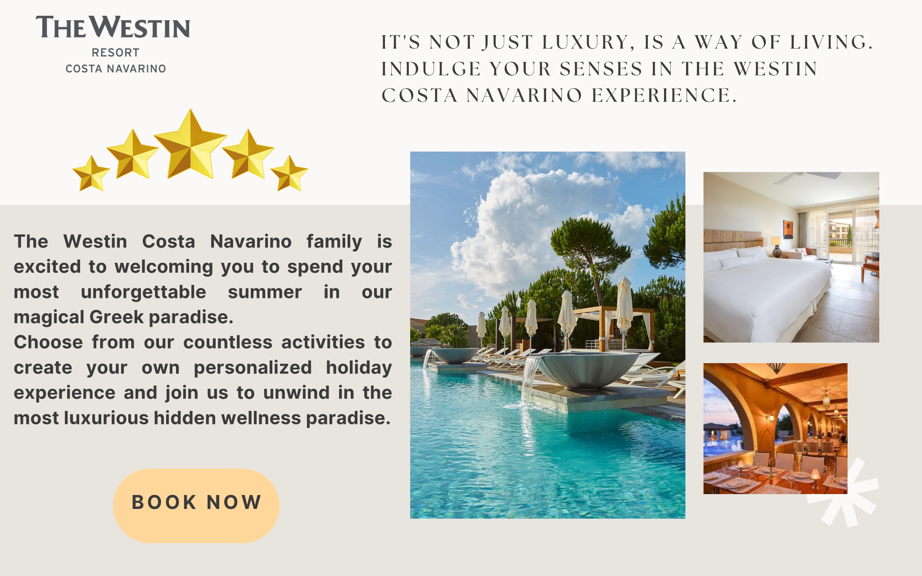
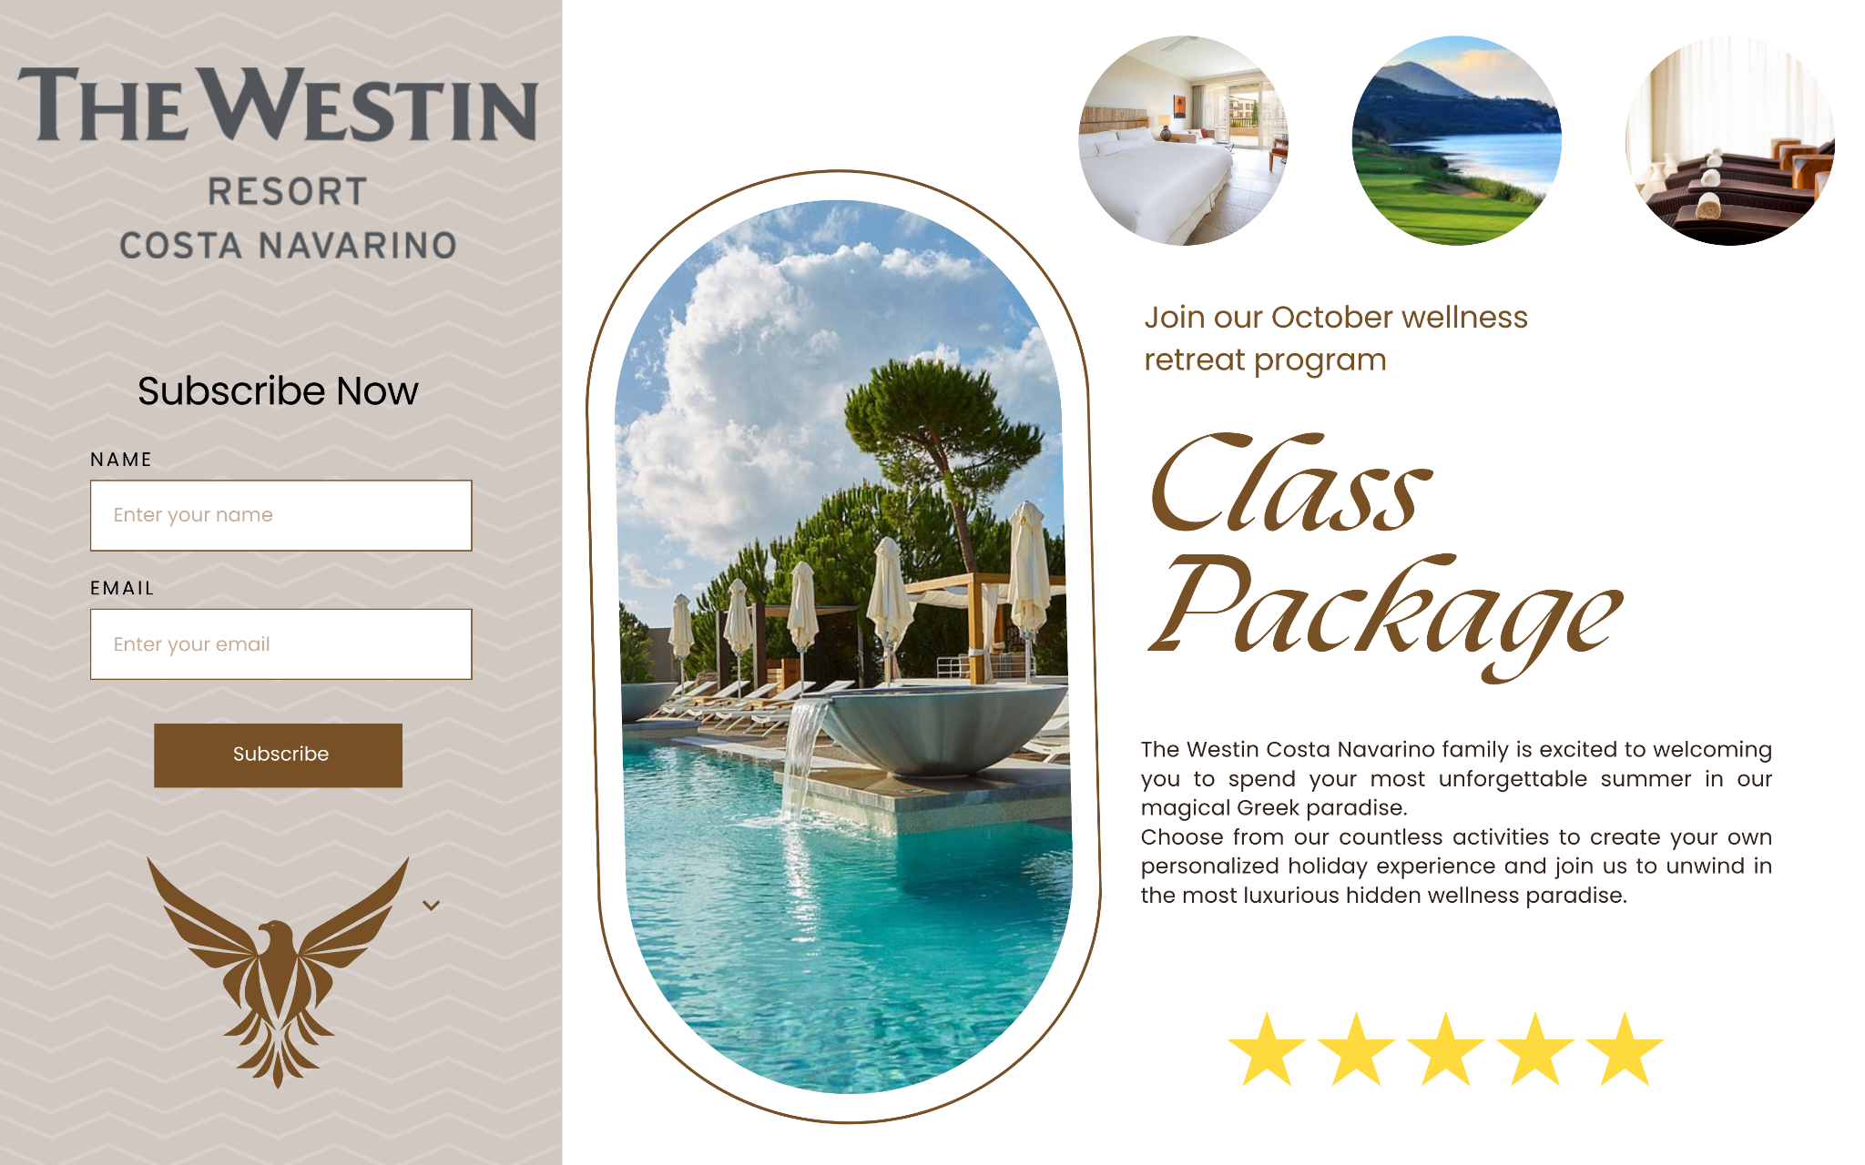
LANDING PAGES

Slide 15
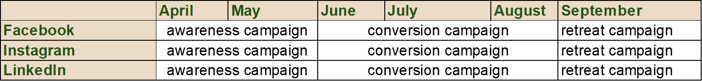
SOCIAL MEDIA
PAID CONTENT CALENDAR
Notes:
April campaign: awareness campaign
June- July: Bookings
September: Retreat

Slide 16
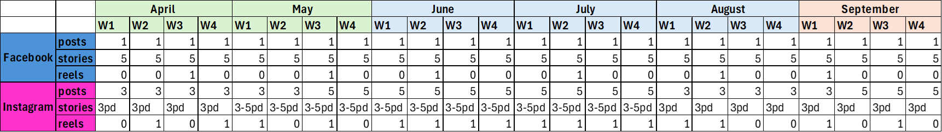
SOCIAL MEDIA
ORGANIC CONTENT CALENDAR
Notes:
Preferred days & times to post: all weekdays from 11am and 4pm, most preferred wednesday, thursday, friday.
Pd: per day
Facebook is more a means to sustain traffic, Instagram will be our main social media channel because of the identity of our persona.

Slide 17
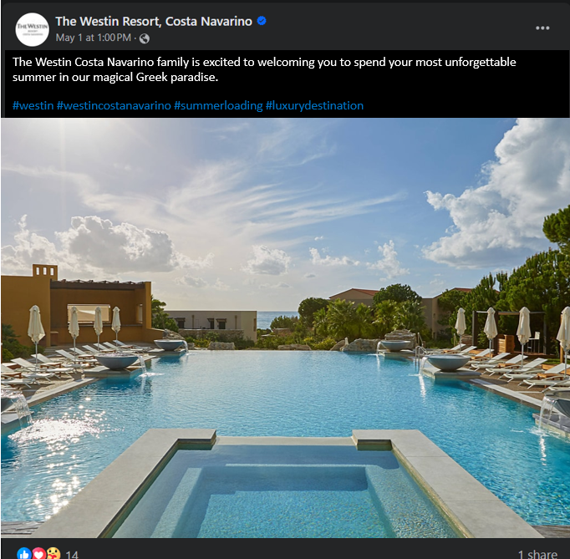
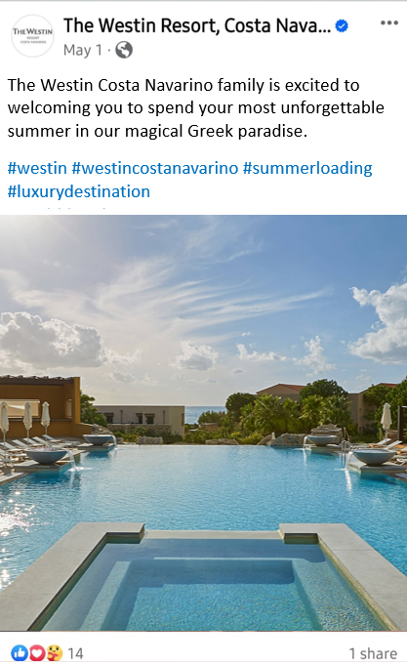
PAID FACEBOOK POSTS
Awareness Campaign

Slide 18
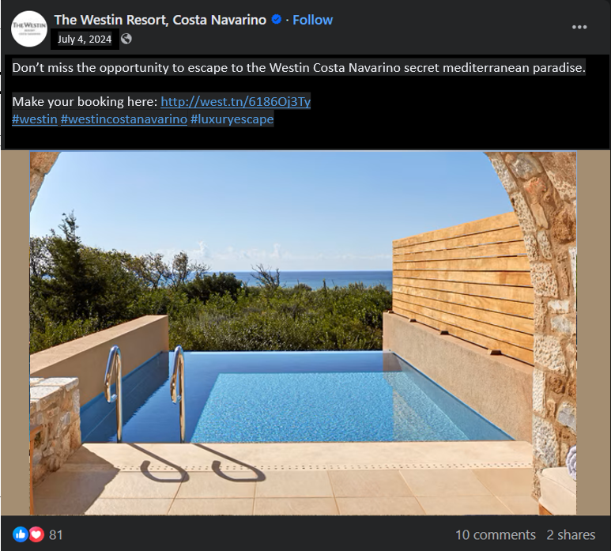
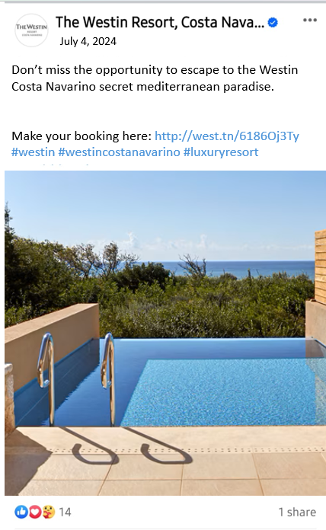
PAID FACEBOOK POSTS
Conversion Campaign

Slide 19
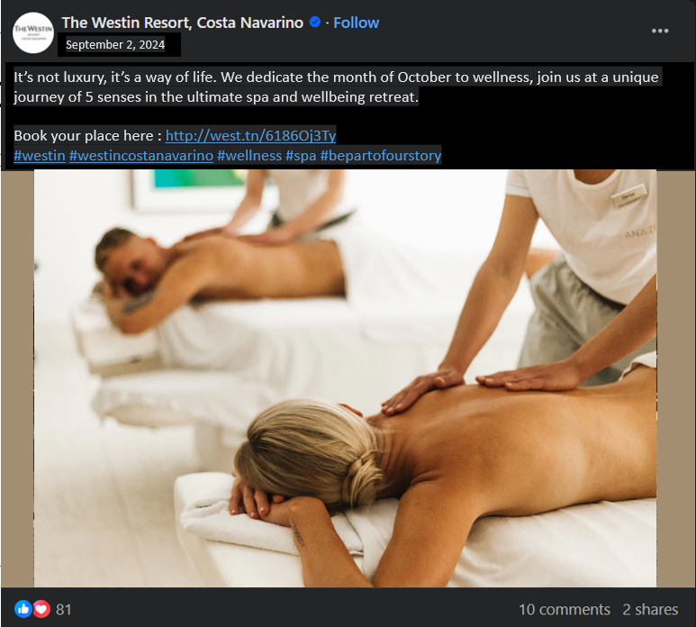
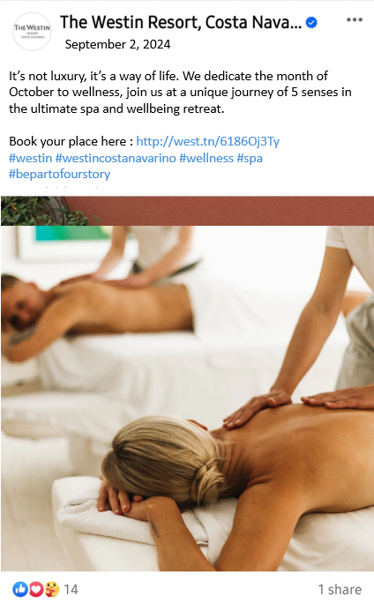
PAID FACEBOOK POSTS
Retreat Campaign

Slide 20
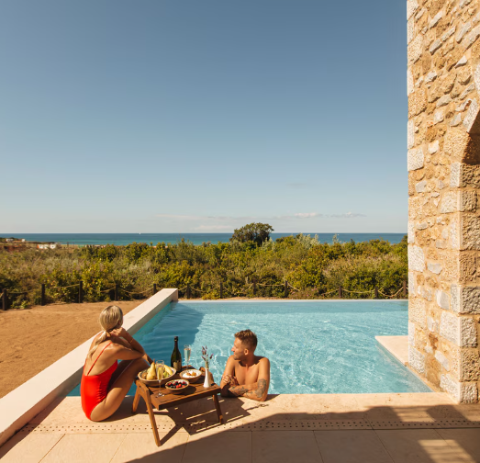
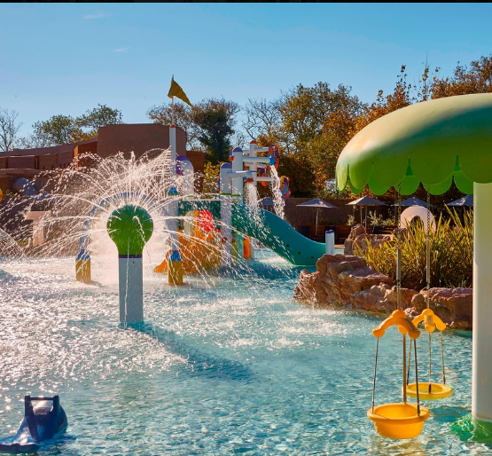
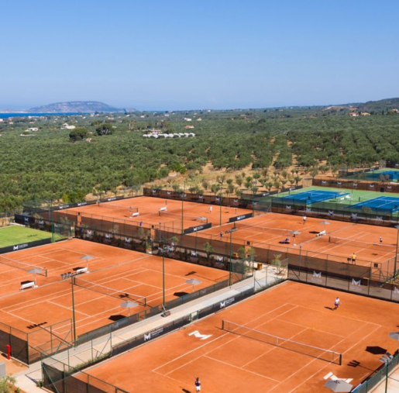
ORGANIC FACEBOOK POSTS
Luxury hideaway
Family destination
Famous Tennis destination

Slide 21
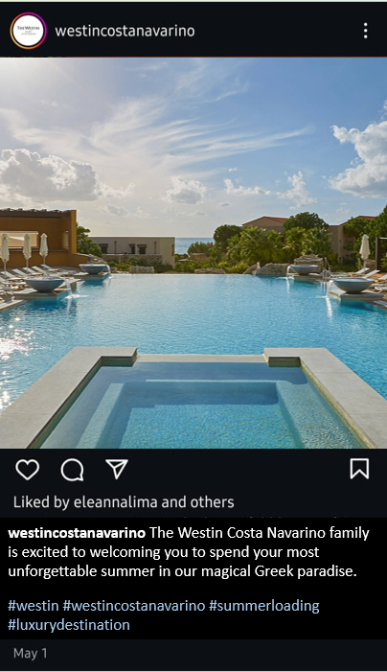
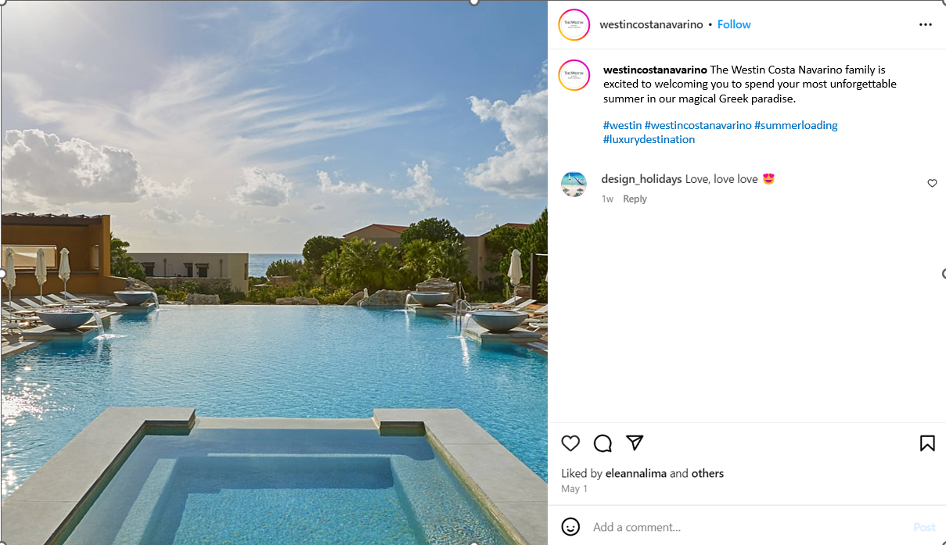
PAID INSTAGRAM POSTS
Awareness campaign

Slide 22
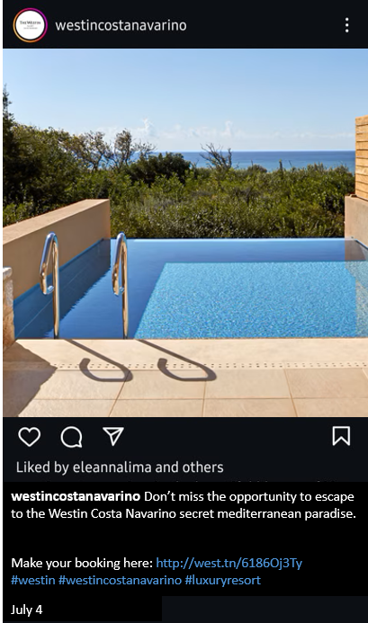
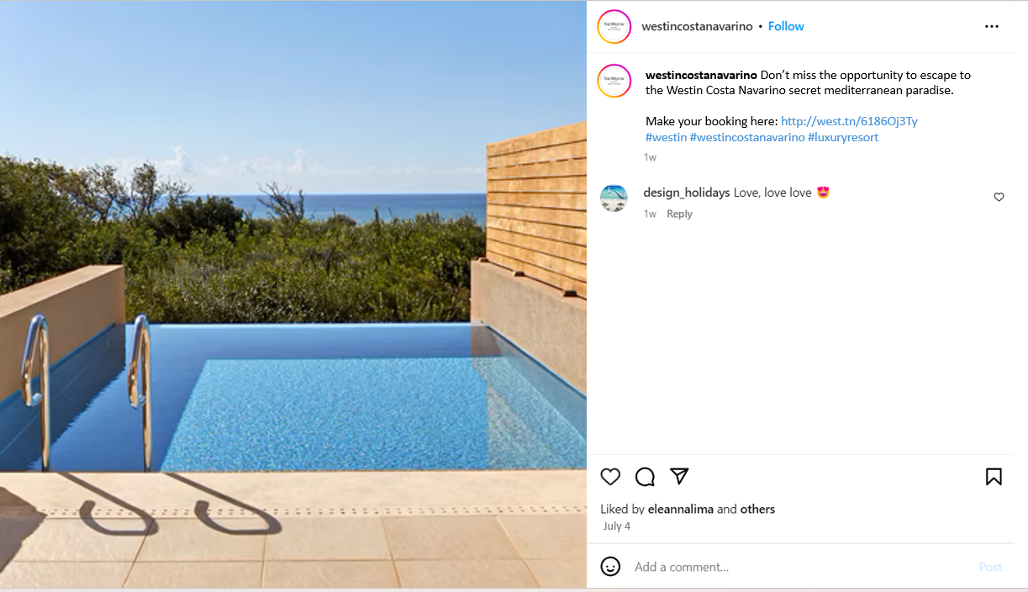
PAID INSTAGRAM POSTS
Conversion campaign

Slide 23
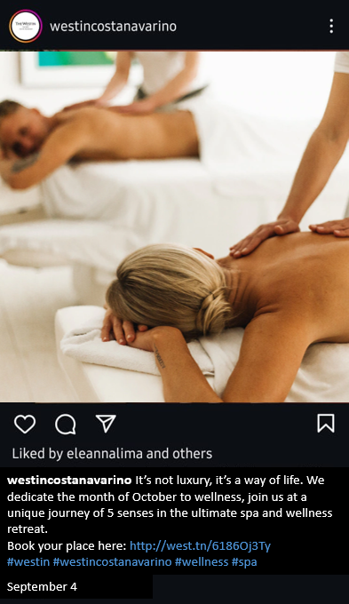
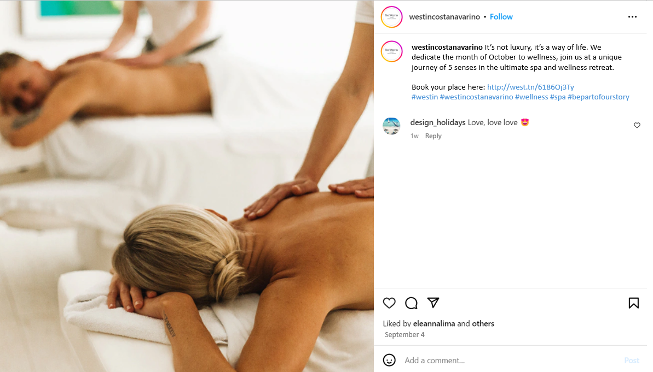
PAID INSTAGRAM POSTS
Retreat campaign

Slide 24
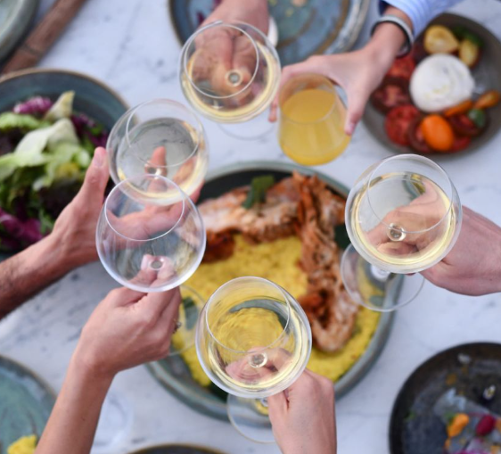
ORGANIC INSTAGRAM POSTS
luxury holidays for all
Luxury hideaway
Family destination
Group of friends high class destination

Slide 25
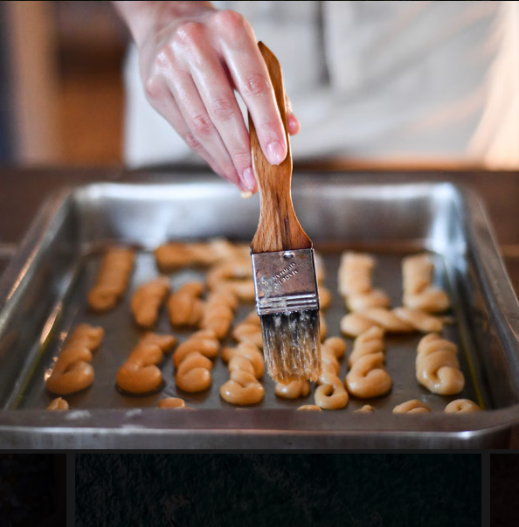
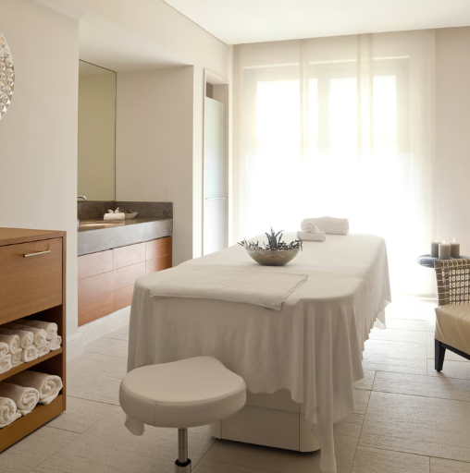
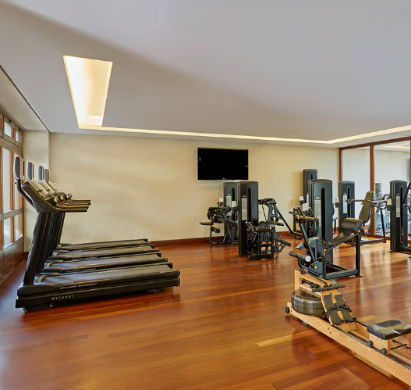
ORGANIC INSTAGRAM POSTS
countless personalized activities
Cooking class
Personalised spa treatments
Fitness

Slide 26
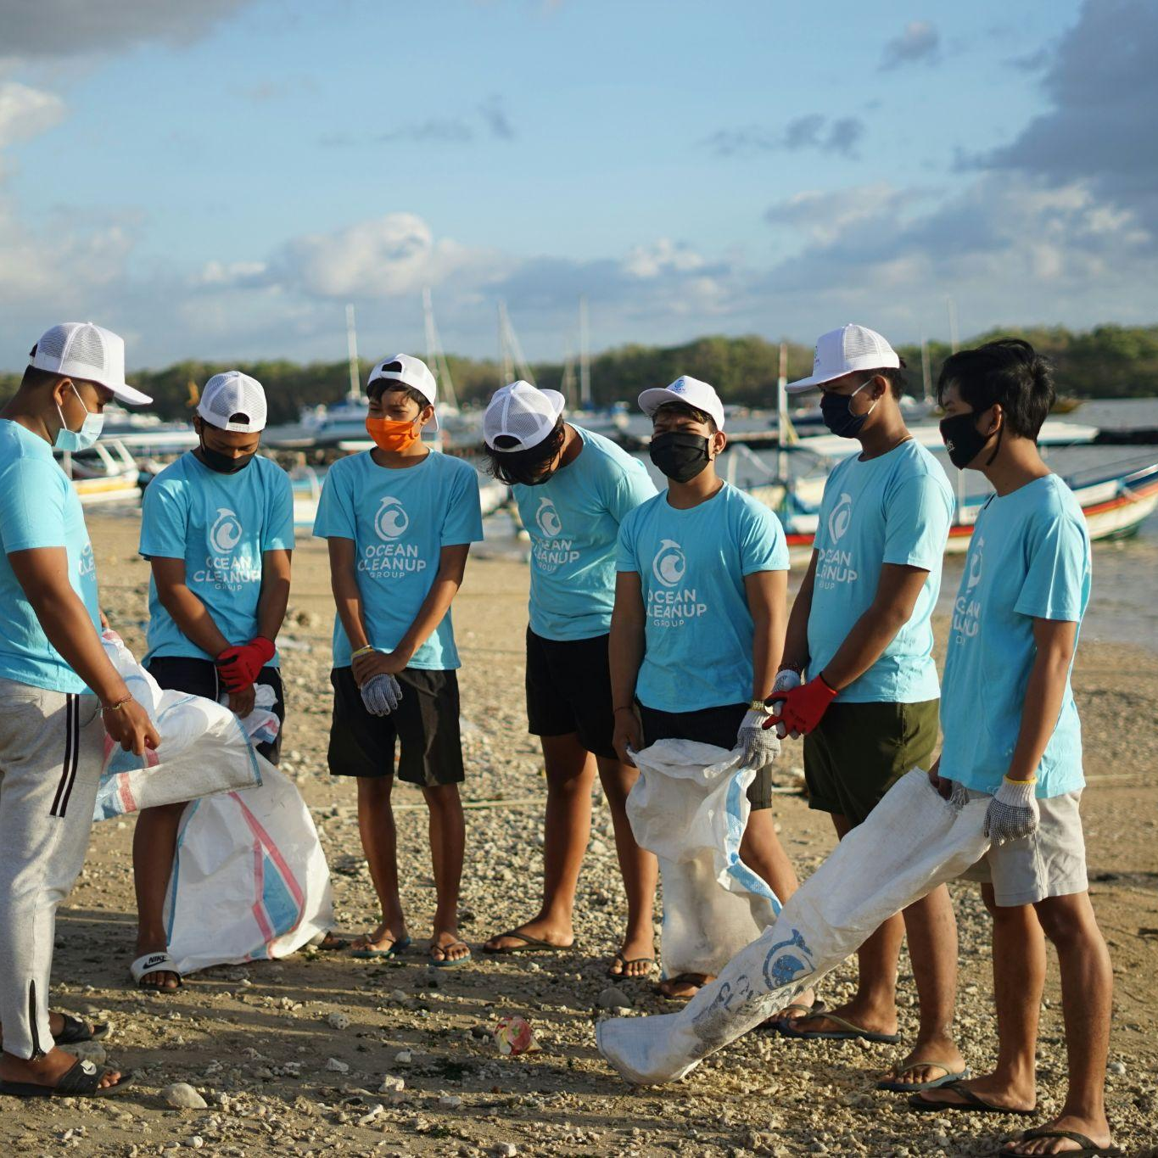
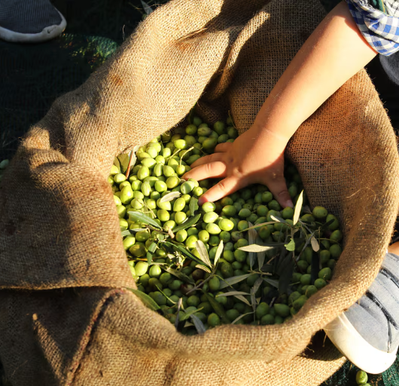
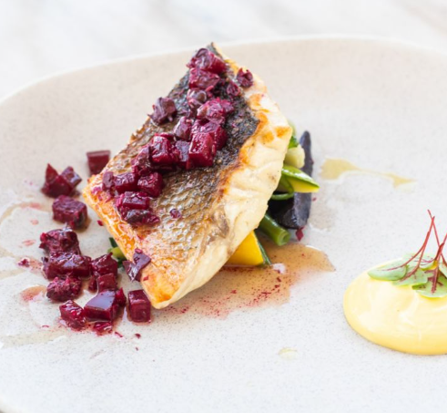
ORGANIC INSTAGRAM POSTS
promote unexplored domains
Active Sustainability presence
Farm-to-table Greek sustainable dining model
Traditional Greek lifestyle

Slide 27
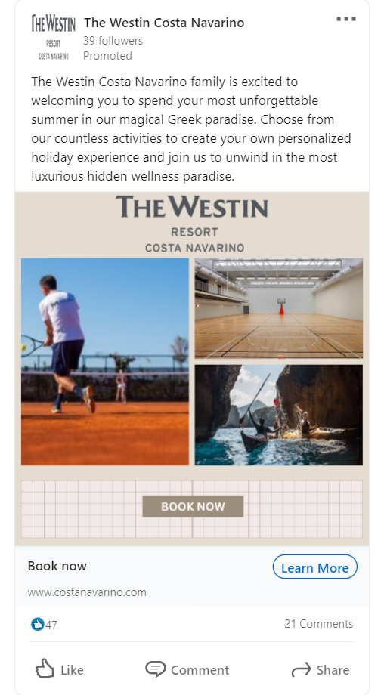
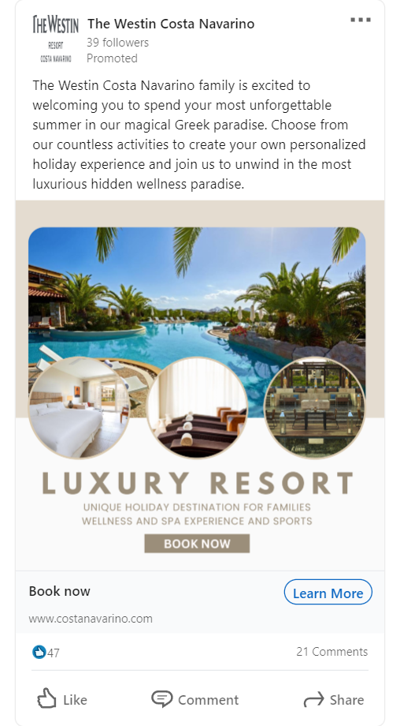
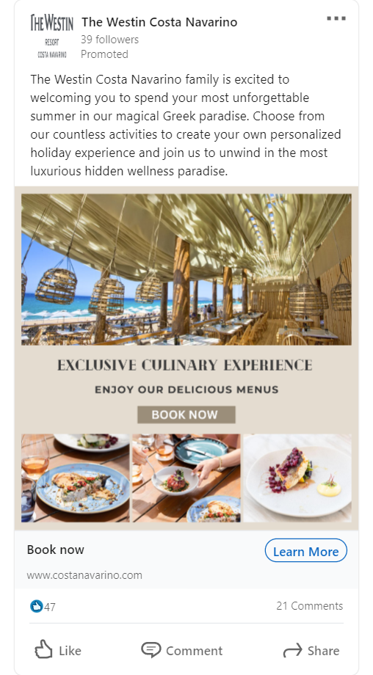
LINKEDIN ADS

Slide 28
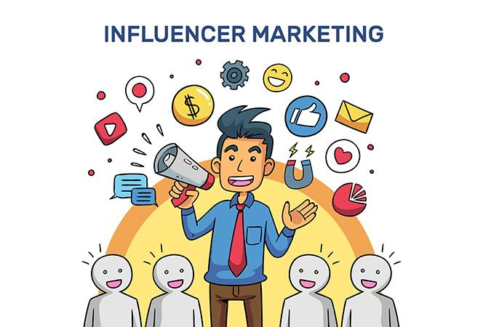
INFLUENCER MARKETING
Barter collab with influencers that match with our target personas
Athina Oikonomakou ( GR | Lifestyle influencer)
Stefanos Tsitsipas (GR | Athlete)
Petra Kvitova ( CZ | Athlete)
Notes:
Oikonomakou_ May, Tsitsipas_July, Kvitova_ July, 1 week in the resort. 3-4 stories, 1 post, 1 teaser story for wellness retreat

Slide 29
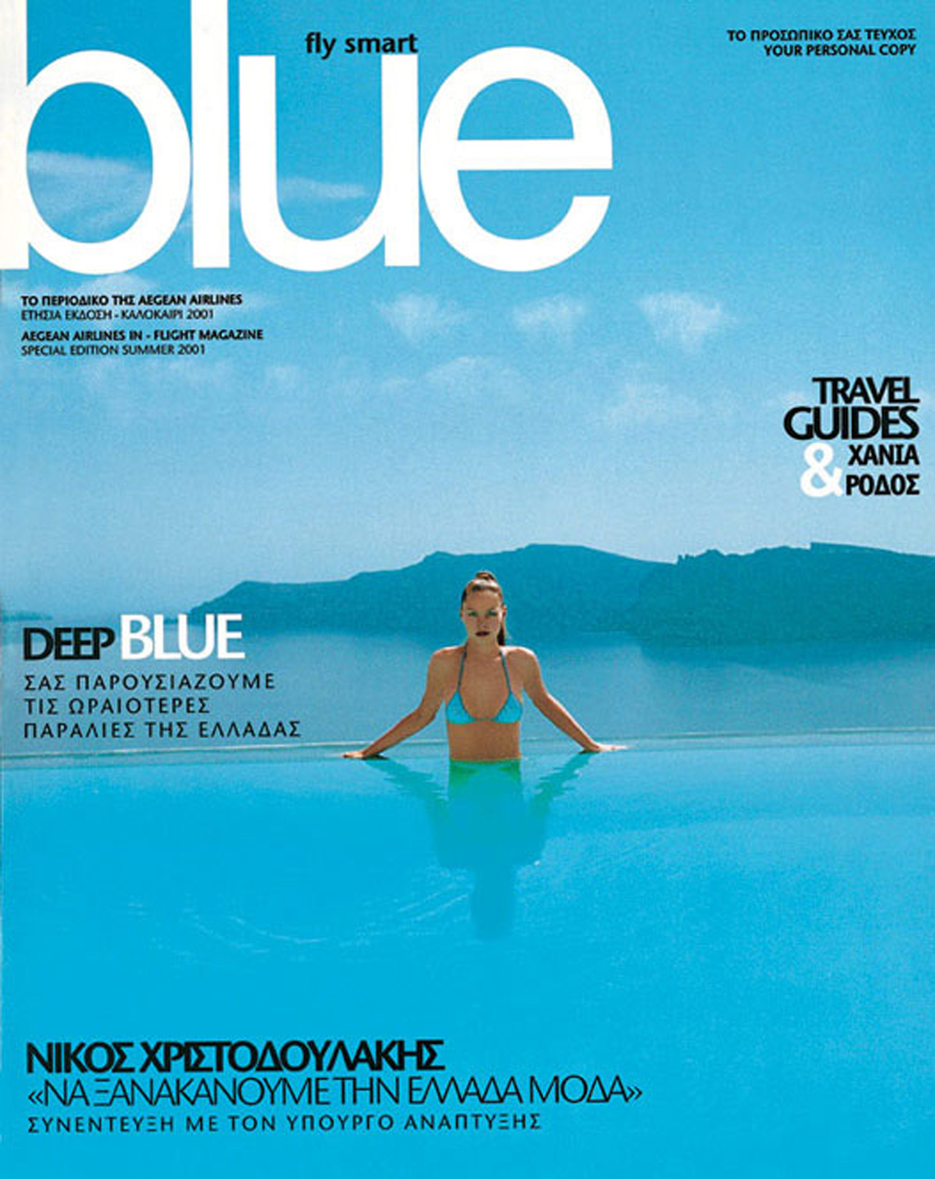
PUBLISHERS
15% OF OUR TOTAL BUDGET
GR
Blue Magazine (print)
INTERNATIONAL
Travel + Leisure (digital)
Notes:
For awareness in spring-summer issue.

Slide 30
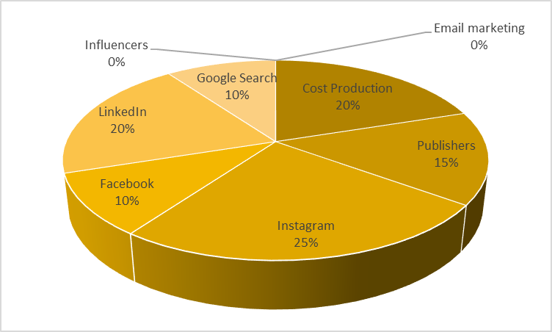
BUDGET ALLOCATION
Influencer collabs
Win-Win cooperation
All inclusive stay for 1 week
(the cost will be deducted from the agency’s fee,
3000€*7 days*3 influencers)
Email newsletters will be sent to previous customers and to all the lists available
Agency Fee 8% on sales
Notes:
Να αφαιρέσουμε από το agency fee το κόστος των influencers

Slide 31
RESULTS
Tool | % of Budget | € Budget | Impressions | Clicks | Bookings
Facebook | 10% | 6000€ | 400.000 | 1500 | 75
Instagram | 25% | 15.000€ | 1.000.000 | 3750 | 187,5
LinkedIn | 20% | 12.000€ | 600.000 | 3000 | 150
Google Search | 10% | 6.000€ | 286.000 | 25000 | 500
Publishers | 15% | 9.000€ |  |  | 0
Total | 80% | 48.000€ |  | 33250 | 912,5
Notes:
CPC google search: 0,24€, CPC insta fb-instagram-linkedin: 4€, Conversion Rate: 5%, cost per thousand impressions (CPM): 15€, ROAS (revenue/cost) =123,2,
CTR: impressions/clicks: fb & insta 0,37%, linkedin 0,5

Slide 32
REVENUE AND AGENCY FEE
Average cost per suite | 500€/ night
Total Bookings | 6.384
Revenue | 3.192.000€
Agency Fee | 255.360€-63.000€=192.360€
Every and each booking will correspond on an average 7 nights stay
Therefore, 7*912=6384 night stays for the total of 6 months and capable capacity of Westin Resort Costa Navarino (445 rooms)

Slide 33

Thank you!

